Slide 1
Price Elasticity
Presented by Pricing Modeling and Analytics Development Team (PUMA-DT)
Nicholas Pylypiw
April 7, 2016

Slide 2
Overview
Business Problem
Definition of Elasticity
Insight Examples
Future State

Slide 3
Basic Example of Demand Curve Projections
Product X has a current price of $2.50, though it has historically been priced between $2.00 and $3.25.
Product X sells about 400 Units a week at the current price.
We wish to model the impact of a 10% increase or decrease in price, recommending action to the merchandising team.

Slide 4
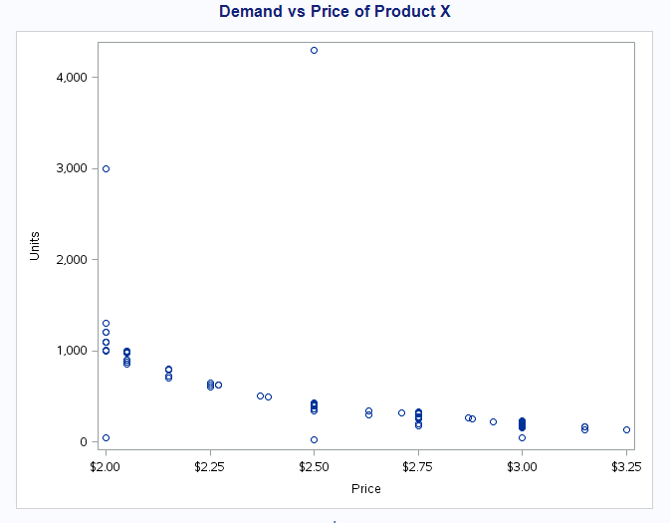
Cleaning Data for Modeling
A quick look at the Demand Curve for this product reveals some potential outliers. We typically scrub these points out, as they do not reflect the product’s typical behavior.

Slide 5
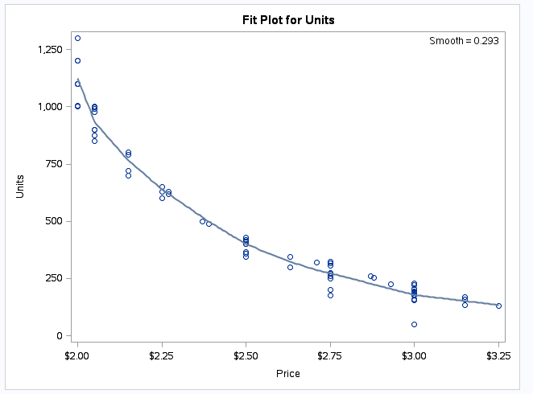
Demand Curve and Tangent Line
Eliminating the outliers and fitting a line to the points allows us to see the nonlinear relationship between price and demand.
The rate of change can be assumed to be the slope of the tangent line to the demand curve at the current price point.

Slide 6
Projecting Demand at Different Price
Using the tangential assumption, one can predict the volume at different price points.
$2.25 ~550 Units
$2.75 ~200 Units

Slide 7
Need for a Standard Metric
We could use this rate of change to make a statement such as:
For every dollar increase in price, demand will decrease by 700 units.
$1.00
700
BUT WE WON’T!!!!!!

Slide 8

What is Elasticity?
Price elasticity is the responsiveness of the quantity demanded to a change in its price.
More specifically, the percentage change in demand per one percent change in price (holding all else constant).
The tangent line to the demand curve, transformed to represent percentage changes.
Bounded below by 0 (almost always…)
Unbounded above
Conventionally discussed in absolute terms.

Slide 9
Elasticity Values
Five scenarios:
E=1 (unit elastic)
0<E<1 (relatively inelastic)
E>1 (relatively elastic)
E=0 (perfectly inelastic)
E→∞ (perfectly elastic)
Price
Percentage change in price equals percentage change in demand
Demand

Slide 10
Elasticity Values
Five scenarios:
E=1 (unit elastic)
0<E<1 (relatively inelastic)
E>1 (relatively elastic)
E=0 (perfectly inelastic)
E→∞ (perfectly elastic)
Price
Percentage change in price is greater than percentage change in demand
Demand

Slide 11
Elasticity Values
Five scenarios:
E=1 (unit elastic)
0<E<1 (relatively inelastic)
E>1 (relatively elastic)
E=0 (perfectly inelastic)
E→∞ (perfectly elastic)
Price
Percentage change in price is less than percentage change in demand
Demand

Slide 12
Elasticity Values
Five scenarios:
E=1 (unit elastic)
0<E<1 (relatively inelastic)
E>1 (relatively elastic)
E=0 (perfectly inelastic)
E→∞ (perfectly elastic)
Price
Large percentage change in price equals negligible percentage change in demand
Demand

Slide 13
Elasticity Values
Five scenarios:
E=1 (unit elastic)
0<E<1 (relatively inelastic)
E>1 (relatively elastic)
E=0 (perfectly inelastic)
E→∞ (perfectly elastic)
Very small percentage change in price equals very large percentage change in demand
Price
Demand

Slide 14
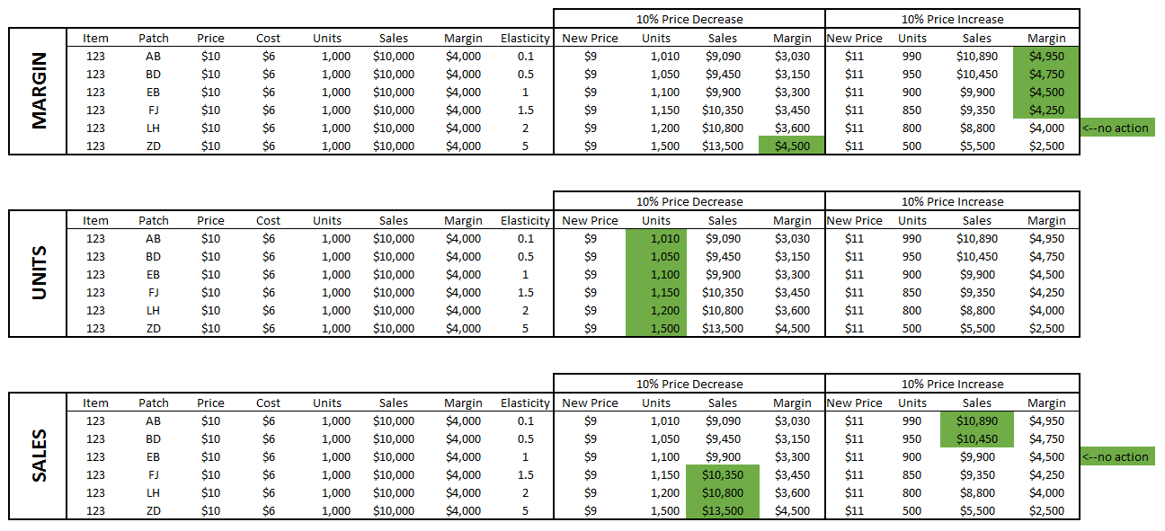
Recommend Actions Based on Goals

Slide 15
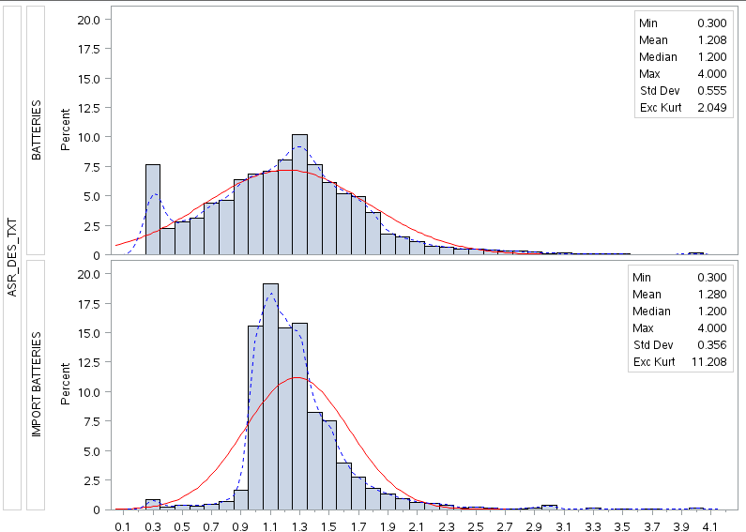
Insight About Products
Using elasticity, we are able to help the merchants guide promotional strategy.
In general, import batteries seem to be a more elastic category than batteries.
This implies that their may be an opportunity to raise retails on batteries, thereby realizing incremental margin $. Also, import batteries may be a traffic driving promotion, due to the high elasticity.

Slide 16
Future State
Finalizing steps of a robust in-house elasticity model (currently relying on third party production).
Views of other lift factors besides price, such as promotional type and vehicle, weather, etc.
Ability to distinguish differences of product’s elasticity for PRO/DIY.
Possibility of redefining pricing clusters.

